Slide 1
Traceability System Update
New Transporter License Functionality
June 10, 2016

Slide 2
Overview of New Functionality
New functionality will allow licensees to:
Transfer inventory outbound through licensed 3rd party transporter licensees.
All examples are created using the WSLCB Traceability System Interface located at wslcb.mjtraceability.com. If you use a third party software system you will need to contact your vendor for system specific instructions

Slide 3
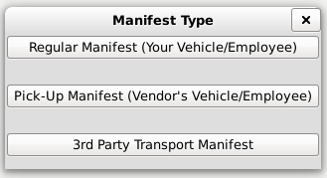
Creating a 3rd Party Transporter Manifest
Click the ‘Transport Manifest’ button.
Select the ‘3rd Party Transport Manifest’ option

Slide 4
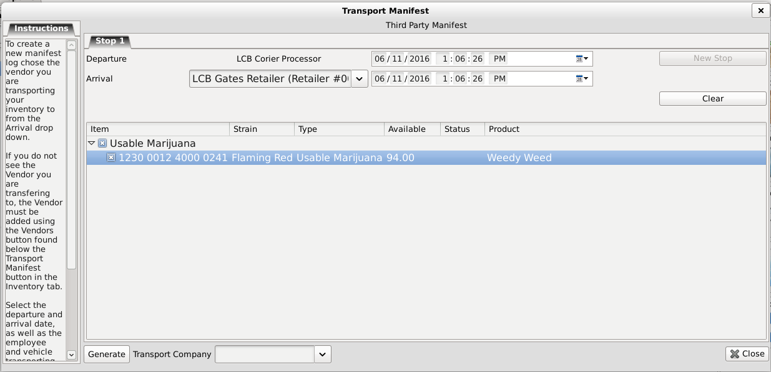
Creating a 3rd Party Transporter Manifest
Generate the manifest as you normally would.

Slide 5
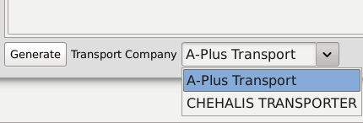
Creating a 3rd Party Transporter Manifest
Select your desired Transport Company from the drop down near the bottom-left side of the window.

Slide 6
Creating a 3rd Party Transporter Manifest
Once you click ‘Generate’, the rest of the process mirrors the current manifest/transfer process.

Slide 7
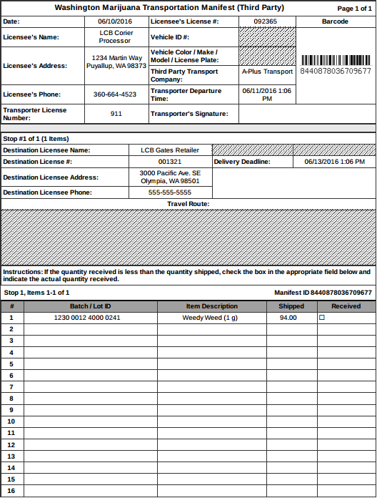
Creating a 3rd Party Transporter Manifest
The transport manifest will not show vehicle information or travel route.

Slide 8
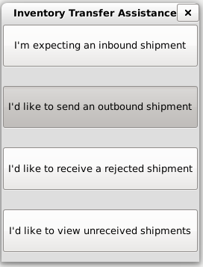
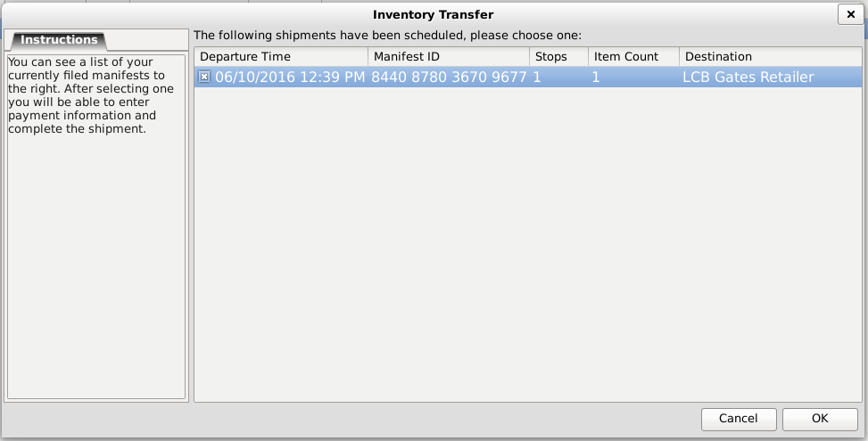
Creating a 3rd Party Transporter Manifest
Transfer outbound normally.

Slide 9
Thank you!

